Slide 1
Extraction of blocks by identifying split vertices & conversion of circuit matrix to diagonal matrix
Presented by
Maharshi Roy (ISM2014006)
Rajat Kumar Sahu(IHM2014501)
Amrit Daimary(IRM2014001)

Slide 2
Methodology and Approach
We will discuss two methods for identifying bi-connected components of which the second method is a better single-pass DFS method with O(V+E) complexity. The graph considered are undirected. And we store the graph as adjacency list.
Naïve method(Recursive Multiple Pass Method)
Single Pass DFS Method

Slide 3
Recursive Multiple Pass Method
We check each vertex recursively for an articulation point.
If we find a vertex as articulation point, we separate the individual components and recursively call the method for those components.
The process of subdivision continues until we reach a stage where each component is a biconnected component and no articulation point remains inside each component.

Slide 4
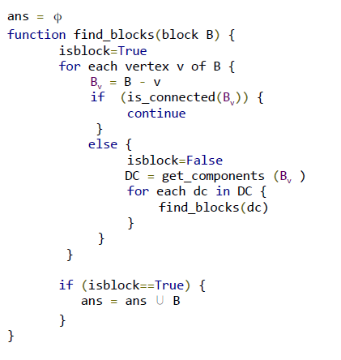
Algorithm

Slide 5
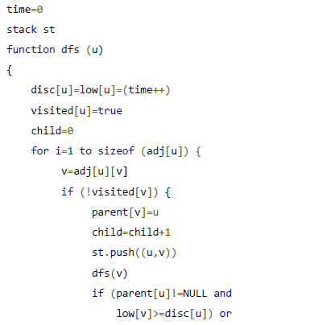
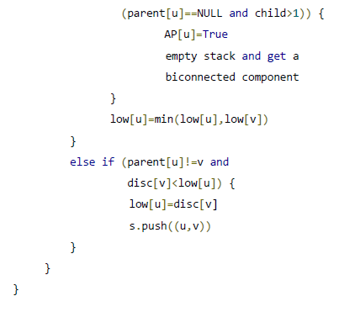
Single Pass DFS Method

Slide 6
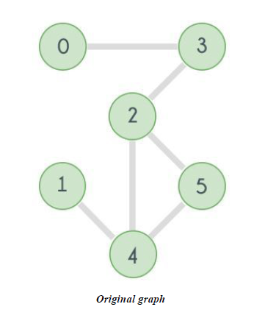
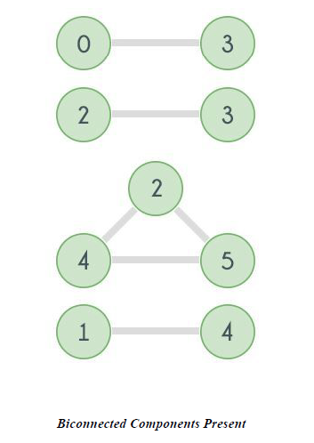
Single Pass DFS Method

Slide 7
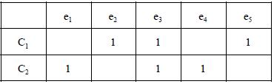
Generating Circuit Matrix
A circuit matrix represents the biconnected components in a more formal manner. The mathematical definition of a circuit matrix is as follows:-
Mij = 1, if edge ej is in circuit Cj
0, otherwise
Thus, we categorically mark the biconnected components obtained C1, C2, C3,......,Cn . and form a matrix as shown below:-
Indicating that
C 1 : {e 2 , e 3 , e 5 }
C 2 : {e 1 , e 3 , e 4 }
are the edges corresponding to the respective circuits.

Slide 8
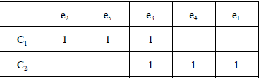
Conversion to Diagonal matrix
With a proper rearrangement of the edges in the columns, we can have a diagonal matrix instead of an arbitrary column matrix as shown below:-
Algorithm:-
1) Accumulate for each circuit the edges present in it.
2) Rearrange the columns for the first circuit suitably,
and mark all those entries corresponding to that
circuit and the edges
3) Repeat 1-2 until no circuit remains

